Slide 1

DATAROBOT – An Overview
- Ramaswamy M

Slide 2
What is DataRobot ?
The DataRobot automated machine learning platform helps data scientists and business analysts discover the best predictive models for every situation, and then deploy them so they can consistently make smarter and faster business decisions that impact their company's bottom line.

Slide 3
What is Automated Machine Learning?
Automated machine learning is a technology invented by DataRobot to automate many of the tasks needed to develop artificial intelligence (AI) and machine learning applications.
Incorporating the knowledge and expertise of some of the world’s top data scientists, DataRobot enables more users across an enterprise to succeed with machine learning by simply utilizing their understanding of their data and business and letting DataRobot do the rest.

Slide 4
Why You Need Automated Machine Learning ?
Automated machine learning takes advantage of the strengths of both humans and computers. Humans excel at communication, engagement, context and general knowledge, as well as creativity and empathy. Computers and software systems are ideal for repetitive tasks, mathematics, data manipulation, and parallel processing — providing the power and speed to master complex solutions.

Slide 5
The 10 Steps of Automated Machine Learning
Step 1:Preparing Data
Step 2:Feature Engineering
Step 3:Diverse Algorithms
Step 4:Algorithm Selection
Step 5:Training and Tuning
Step 6:Ensembling
Step 7:Head-to-Head Model Competitions
Step 8:Human-Friendly Insights
Step 9:Easy Deployment
Step 10:Model Monitoring and Management

Slide 6
The 10 Steps of Automated Machine Learning
Step 1:Preparing Data
Step 2:Feature Engineering
Step 3:Diverse Algorithms
Step 4:Algorithm Selection
Step 5:Training and Tuning
Step 6:Ensembling
Step 7:Head-to-Head Model Competitions
Step 8:Human-Friendly Insights
Step 9:Easy Deployment
Step 10:Model Monitoring and Management

Slide 7
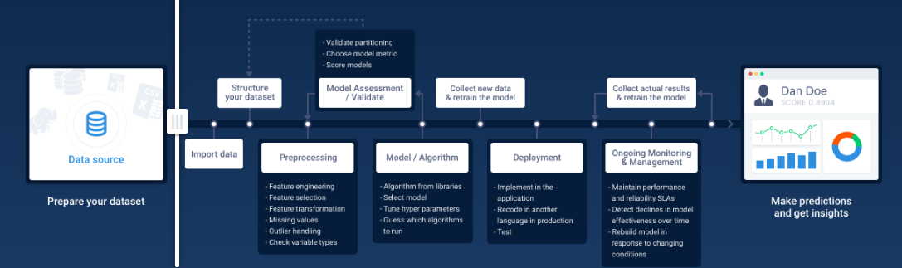
How DataRobot Automates Predictive Modeling
Old Way

Slide 8
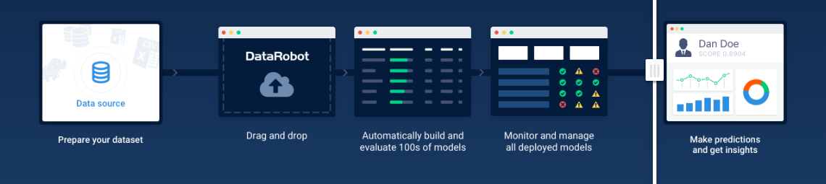
How DataRobot Automates Predictive Modeling
With DataRobot

